Slide 1
Rocksoft City Hospital
Ryan Bleile, Ankit Adlakha, David Donangelo, Rendall Cabaccang, Chloe Umble

Slide 2
Rocksoft City Hospital
Over the last 10 years, increase in patient demand have have put significant pressures on all parts of the hospital.
Patients are competing with each other for treatments and medical personnel.
More patients are leaving the hospital without being seen.
Simulation analysis helps to improve hospital operation efficiency.

Slide 3
Facility Details
ED consists of:
One check-in counter
One 2-desk registration area adjacent to check-in
Six standard treatment rooms, generally used for non-critical patients
Two trauma rooms, only used for critical patients
Diagnostic Imaging consists of:
One imaging area (in which only a single person can be seen at a time)
(The process to analyze the images is outside the scope of this model)

Slide 4
Continues Facility Details
Diagnostic Lab consists of:
Two draw stations where blood and urine samples are collected
(The process to analyze the lab work is outside the scope of this model)
Surgery consists of:
Three operating rooms (ORs)
(OR operation has been placed outside the scope of this model)

Slide 5
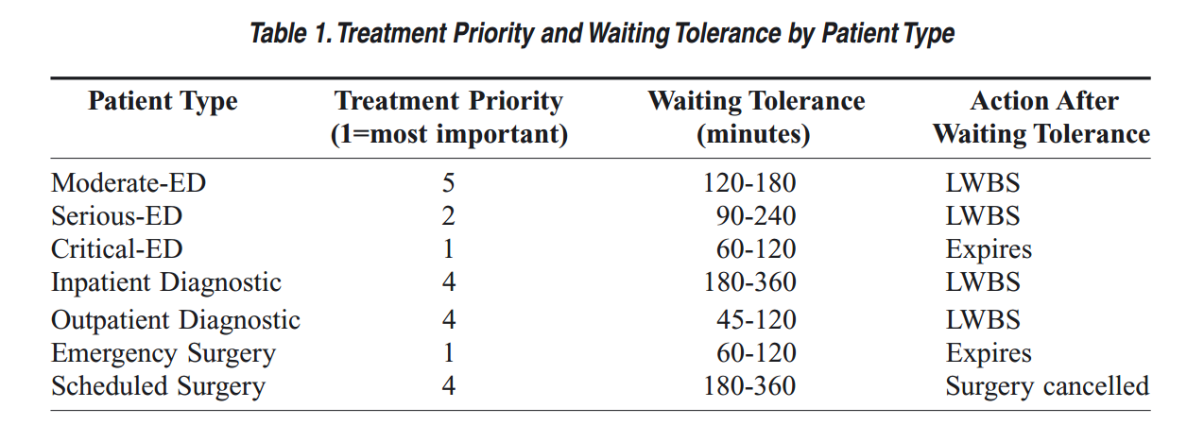

Slide 6
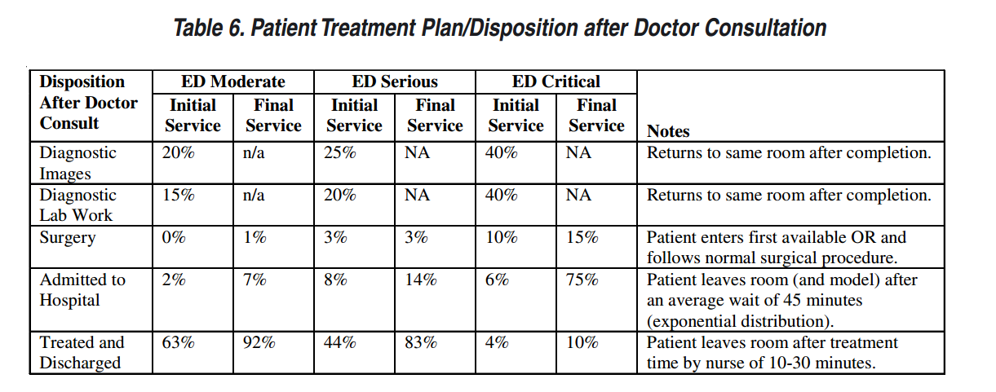

Slide 7
Operational Details
Three types of ED Patients
Moderate ED
Serious ED
Critical ED
Two types of non-ED Patients
Outpatient diagnostics
Inpatient diagnostics
Other patients are outside the scope of our simulation

Slide 8
Operational Details Cont.
ED Patients require:
Check-in
Nurse Prep
Initial Doctor visit
Diagnostics / Treatment
Non-ED Patients only interact with our simulation in the diagnostics departments
other hospital requirements are outside the simulation

Slide 9
Operational Details Cont.
Treatments include
Diagnostic Imaging
Diagnostic Labs
Surgery
Hospital Admittance
Discharge
ED Patients leave system scope by entering three of five treatments
Surgery
Hospital Admittance
Discharge

Slide 10
Measures of Effectiveness
Time until treatment
"door-to-doctor" time
Total operating cost
Per week Basis
Time until first seen
"door-to-seen" time / time till registration
Total time in system
The percent VAT (value-added time)
the total time being given care divided by the total time in the system

Slide 11
Measures of Effectiveness Cont.
Percent of LWBS Patients
("Leave-Without-Being-Seen", or critical patients who passed away in waiting room)
Resource Utilization
Rooms and personnel by type

Slide 12
Experiments to Run
Determine best Staffing Schedules
Best schedules for surgeries or diagnostics
How to best meet JCHA critical door-to-treatment time
How are other patients affected by JCHA critical dtt time
Annual increase in patients effect on effectiveness

